Slide 1
STRATEGIC MARKETING
Implementing Marketing Strategies:
Managing and Developing New Products
Prof. Mohammed Rafiq
Professor of Marketing

Slide 2
New product development and product life-cycle strategies
Topic outline
New product development strategy
New product development process
Managing new product development
Product life-cycle strategies

Slide 3
What is a product?
Products, services and experiences
Product is anything that can be offered in a market for attention, acquisition, use or consumption that might satisfy a need or want.
Service is a product that consists of activities, benefits or satisfaction that is essentially intangible and does not result in the ownership of anything.

Slide 4
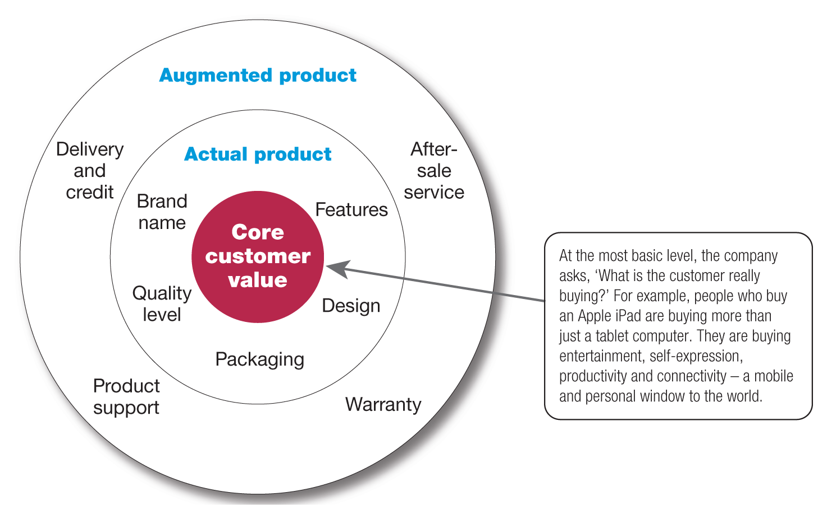
What is a product? (Continued)
Levels of product and services

Slide 5
Google: Innovation Excellence
Google’s Success
Highly Innovative: Google regularly tops list of the world’s most innovative firms,
Market Share: In a competitive market, Google’s core business (online search) market share of 86% is 5 times the combined share of all its competitors.
Ad Revenues: Google captures 70% of all U.S. search-related ad revenues.
How Do They Do It
Light Speed Innovation: New product planning looks ahead only four to five months; firm strives to take the fastest path to new product development.
Idea Generation: Ideas come from any source or employee. Engineers spend 20% of time developing their own new ideas.
New Product Testing: New applications are launched at early stage (beta) users test and provide feedback. Product development is iterative.

Slide 6
New-Product Failures
Why do new products fail?
Overestimation of market size.
Product design problems.
Incorrectly positioned, priced, or advertised.
Pushed by high level executives despite poor marketing research findings.
Excessive development costs.
Competitive reaction.

Slide 7
NPD Failure is High
It is estimated that 90% of new consumer products launched in Europe fail!
66% fail within 2 years

Slide 8
New product development strategy
Two ways to obtain new products
Acquisition refers to the buying of a whole company, a patent or a license to produce someone else’s product.
New product development refers to the development of original products, product improvements, product modifications and new brands through the firm’s own product development efforts.

Slide 9
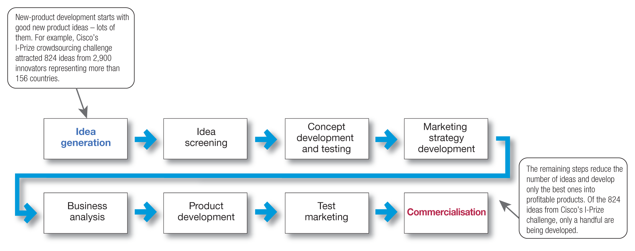
New product development process
Major stages in new product development

Slide 10
New product development process (Continued)
Idea generation
Idea generation is the systematic search for new product ideas.
Sources of new product ideas
Internal
External.

Slide 11
New product development process (Continued)
Idea generation
Internal idea sources refer to the company’s own formal research and development, management and staff, and intrapreneurial programmes.
External sources refer to sources outside the company such as customers, competitors, distributors, suppliers and outside design firms.

Slide 12
New product development process (Continued)
Crowdsourcing
Inviting broad communities of people—
customers, employees, independent
scientists and researchers and even the
public at large—into the new product
innovation process.

Slide 13
New product development process (Continued)
Idea screening
Identify good ideas and drop poor ideas.
R-W-W screening framework:
Is it real?
Can we win?
Is it worth doing?

Slide 14
New product development process (Continued)
Concept development and testing
Product idea is an idea for a possible product that the company can see itself offering to the market.
Product concept is a detailed version of the idea stated in meaningful consumer terms.
Product image is the way consumers perceive an actual or potential product.

Slide 15
New product development process (Continued)
Concept development and testing
Concept testing refers to testing new product concepts with a group of target consumers to find out if the concepts have strong consumer appeal.

Slide 16
New product development process (Continued)
Marketing strategy development
Marketing strategy development involves designing an initial marketing strategy for a new product based on the product concept.
Marketing strategy statement includes:
Description of the target market
Value proposition
Sales and profit goals.

Slide 17
New product development process (Continued)
Marketing strategy development
Business analysis involves a review of the sales, costs and profit projections to find out whether they satisfy the company’s objectives.

Slide 18
New product development process (Continued)
Marketing strategy development Product development
Involves the creation and testing of one or more physical versions by the R&D or engineering departments.
Requires an increase in investment.
Shows whether the product idea can be turned into a workable product.

Slide 19
New product development process (Continued)
Marketing strategy development
Test marketing is the stage at which the product and marketing programme are introduced into more realistic marketing settings.
Provides the marketer with experience in testing the product and entire marketing programme before full introduction.

Slide 20
New product development process (Continued)
Types of test markets
Simulated test markets
Standard test markets
Controlled test markets

Slide 21
New product development process (Continued)
Marketing strategy development
Advantages of simulated test markets
Less expensive than other test methods
Faster
Restricts access by competitors.
Disadvantages
Not considered as reliable and accurate due to the controlled setting.

Slide 22
New product development process (Continued)
Marketing strategy development
When firms test market
New product with large investment
Uncertainty about product or marketing programme
When firms may not test market
Simple line extension
Copy of competitor product
Low costs
Management confidence

Slide 23
New product development process (Continued)
Marketing strategy development
Commercialisation is the introduction of the new product.
When to launch
Where to launch
Planned market rollout.

Slide 24
Managing new product development
Successful new product development should be:
customer-centred
team-based
systematic.

Slide 25
Managing new product development (Continued)
New product development strategies
Customer-centred new product development: new ways to solve customer problems and create more customer satisfying experiences.

Slide 26
Managing new product development (Continued)
New product development strategies
Sequential new product development: company departments work closely together individually to complete each stage of the process before passing it along to the next department or stage.
Increased control in risky or complex projects but may be slow.

Slide 27
Managing new product development (Continued)
New product development strategies
Team-based new product development: Various company departments work closely together, overlapping the steps in the product development process to save time and increase effectiveness.

Slide 28
Managing new product development (Continued)
New product development strategies
Systematic new product development:
innovative development approach that collects, reviews, evaluates and manages new product ideas.
Creates an innovation-oriented culture.
Yields a large number of new product ideas.

Slide 29
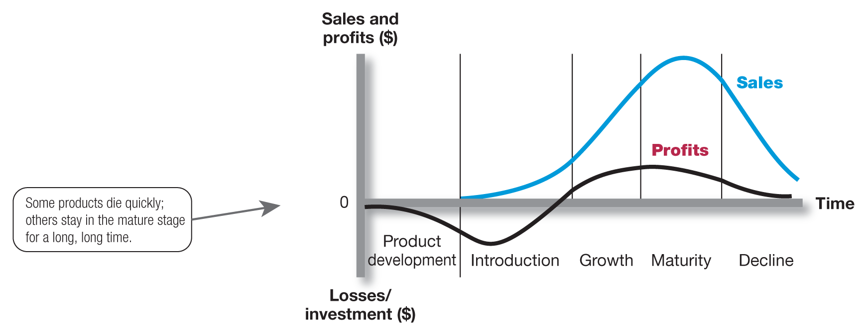
Product life-cycle strategies
Product life cycle

Slide 30
Product life-cycle strategies (Continued)
Product development
Sales are zero and investment costs mount.
Introduction
Slow sales growth and profits are non-existent.
Growth
Rapid market acceptance and increasing profits.
Maturity
Slowdown in sales growth and profits level off or decline.
Decline
Sales fall off and profits drop.

Slide 31
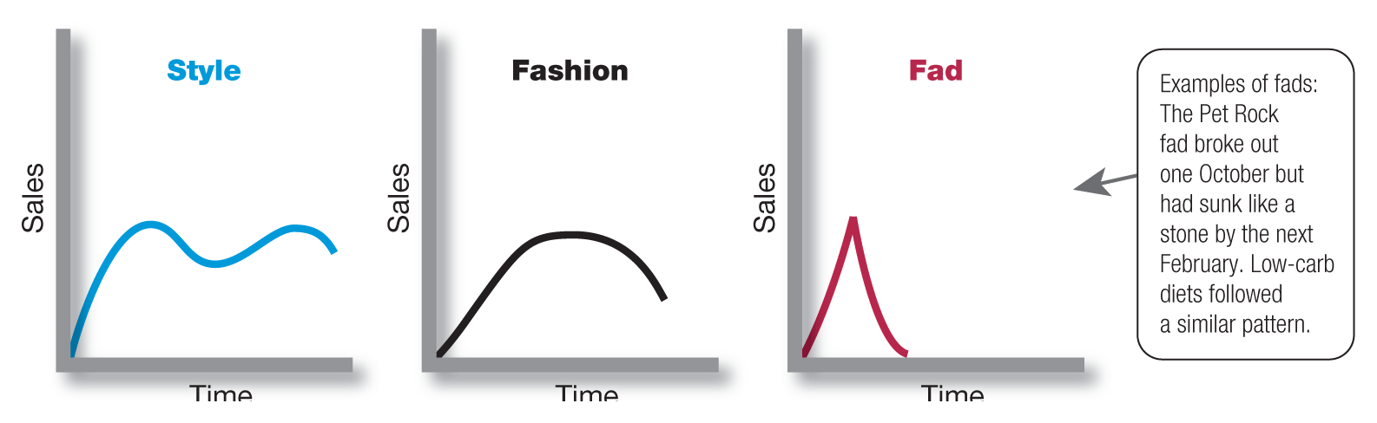
Product life-cycle strategies (Continued)

Slide 32
Product life-cycle strategies (Continued)
Fads are temporary periods of unusually high sales driven by consumer enthusiasm and immediate product or brand popularity.

Slide 33
Product life-cycle strategies (Continued)
Introduction stage
Slow sales growth
Little or no profit
High distribution and promotion expense.

Slide 34
Product life-cycle strategies (Continued)
Growth stage
Sales increase
New competitors enter the market
Price stability or decline to increase volume
Consumer education
Profits increase
Promotion and manufacturing costs gain economies of scale.

Slide 35
Product life-cycle strategies (Continued)
Maturity stage
Slowdown in sales
Many suppliers
Substitute products
Overcapacity leads to competition
Increased promotion and R&D to support sales and profits.

Slide 36
Product life-cycle strategies (Continued)
Maturity stage modifying strategies
Market modifying
Product modifying
Marketing mix modifying.

Slide 37
Product life-cycle strategies (Continued)
Decline stage
Maintain the product
Harvest the product
Drop the product.

